Slide 1
The Basic Science of Skin and Anti-Aging
From
The Product Knowledge Training Manual
in The Source

Slide 2
The Enemy

Slide 3
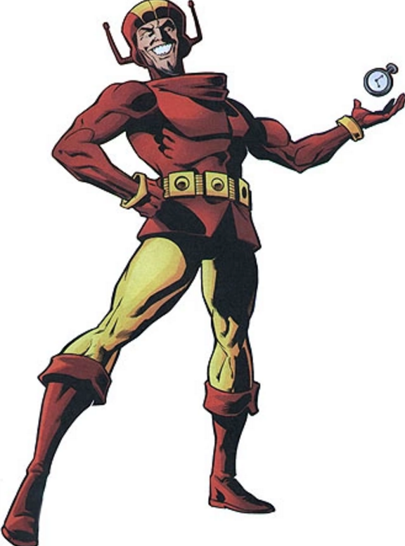
Time

Slide 4
The Hero

Slide 5
RE9 Advanced

Slide 7
Nine Signs of Aging

Slide 8
Youthful Skin
1. Smooth
2.Radiant
3.Healthy glow
4.Moisturized
5.Even toned (without age spots)
6.Firm
7.Resilient
8.Less sensitive
9.No lines or wrinkles

Slide 9
Aging Skin
1.Rough
2.Dull
3.Tired
4.Dry
5.Dark age spots are visible
6.Sagging
7.Loose
8.Reddened
9.Lines and wrinkles

Slide 10
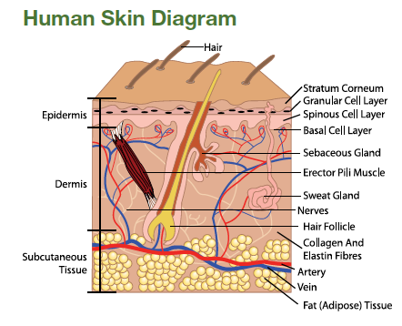
Three Layers of Skin
(1) Epidermis
(2) Dermis
(3) Hypodermis or Subcutaneous Layer (Fat Layer)

Slide 11
Epidermis

Slide 12
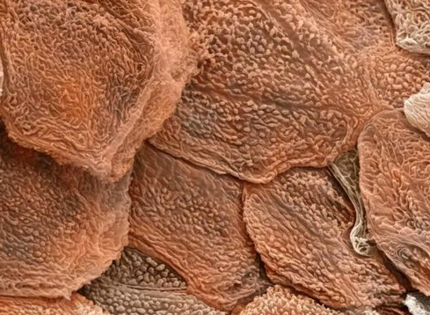
Horny Layer

Slide 13
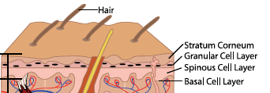
Basal Layer
Deeper within the epidermis is the basal layer

Slide 14
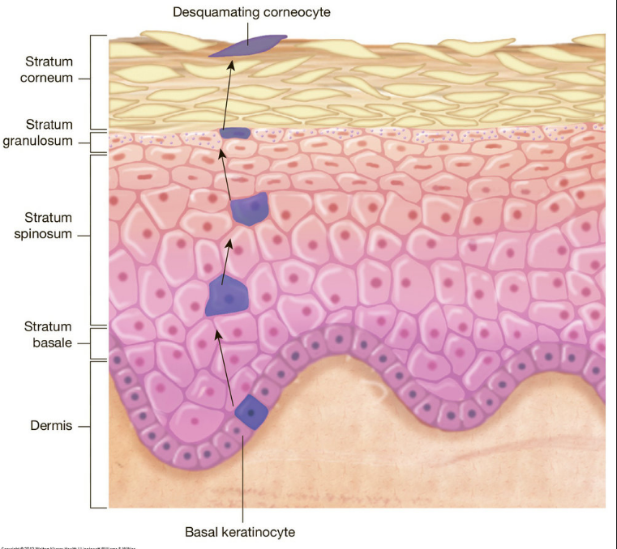
Natural Cell Turnover
New skin cells are produced deep within the dermal matrix.
These cells migrate upwards toward the surface as they mature. Approximately 25 to 30 layers of dead skin cells, the result of keratinization, comprise the outer layer you see.

Slide 15
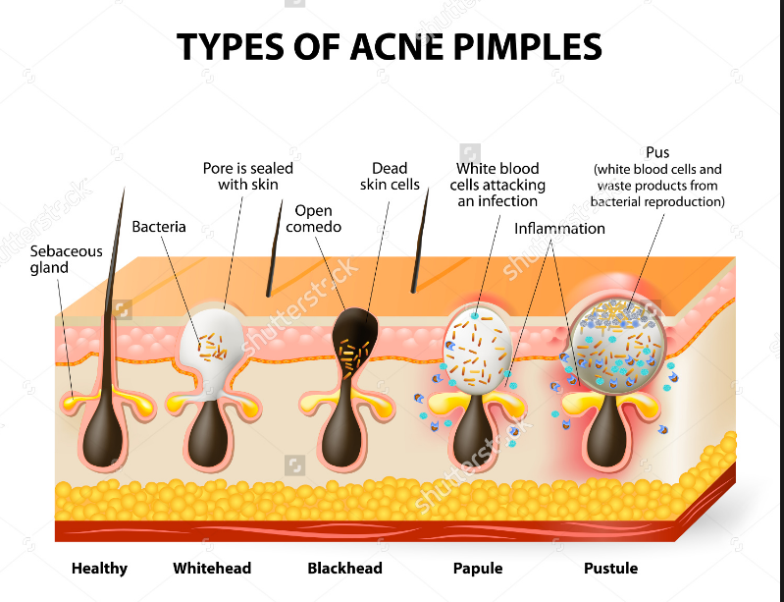
.

Slide 16
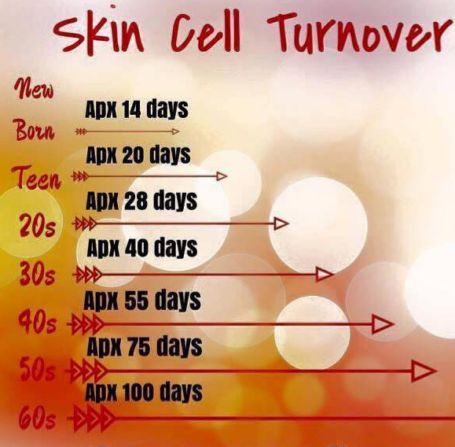
Cell Turnover Rate

Slide 17
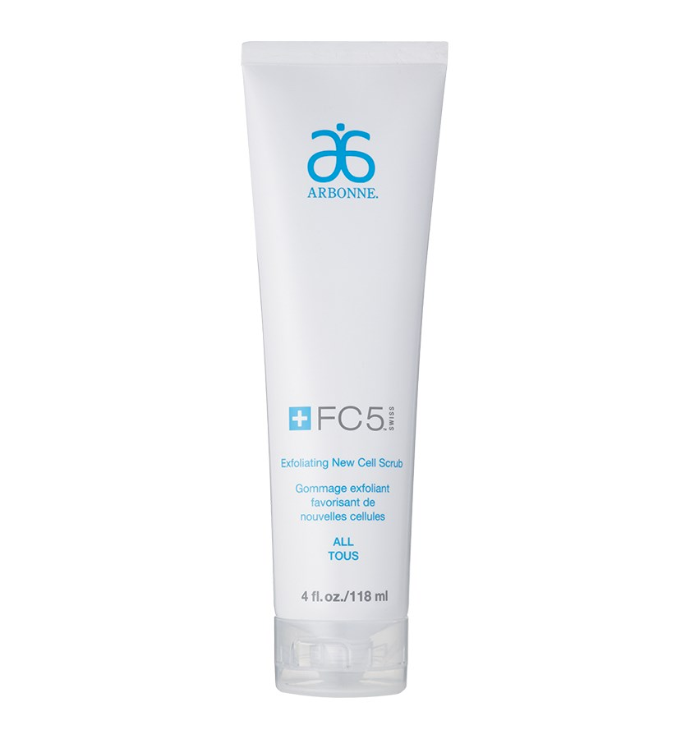
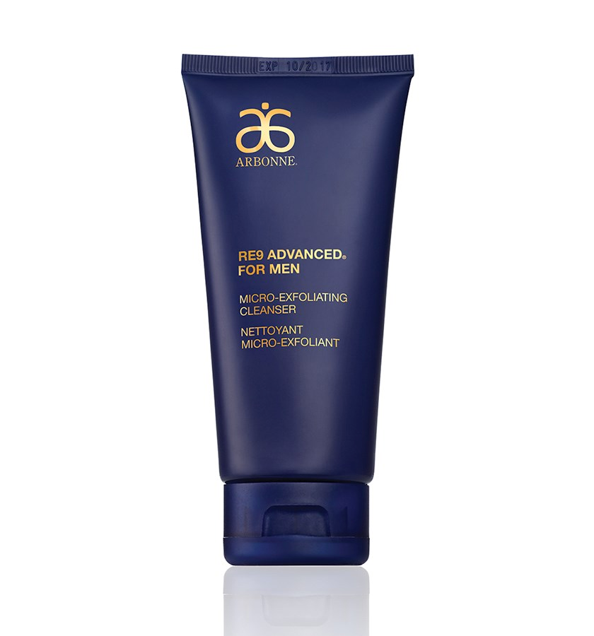
Manual Exfoliation

Slide 18
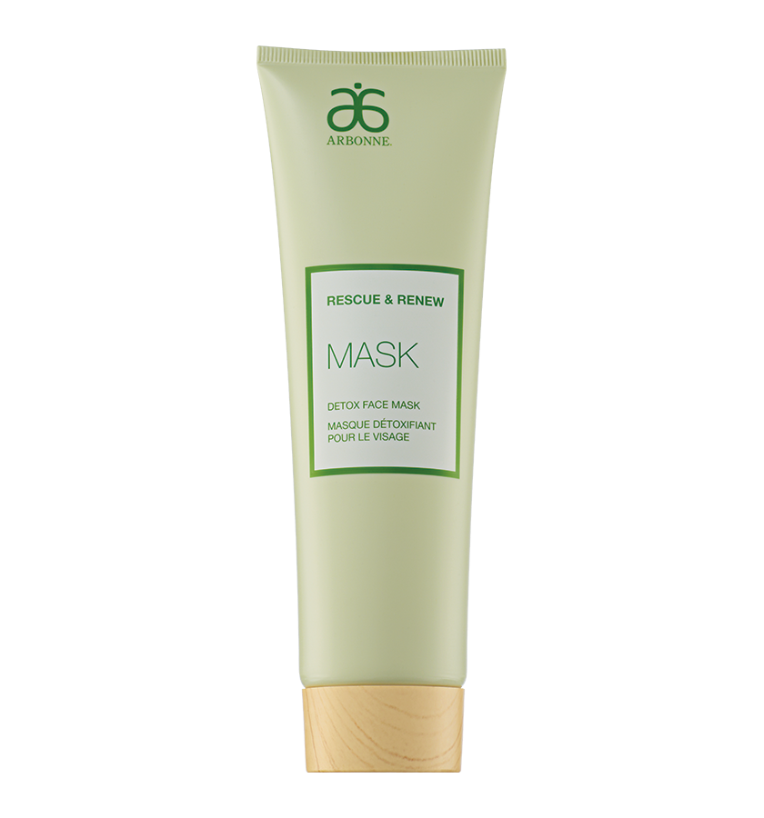
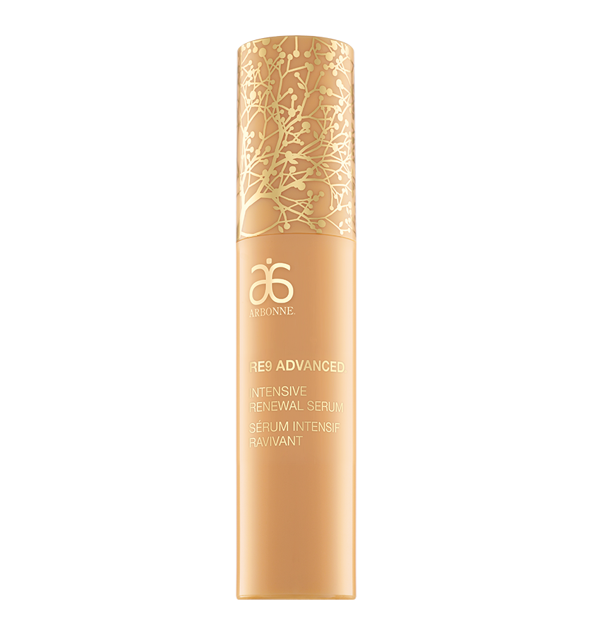
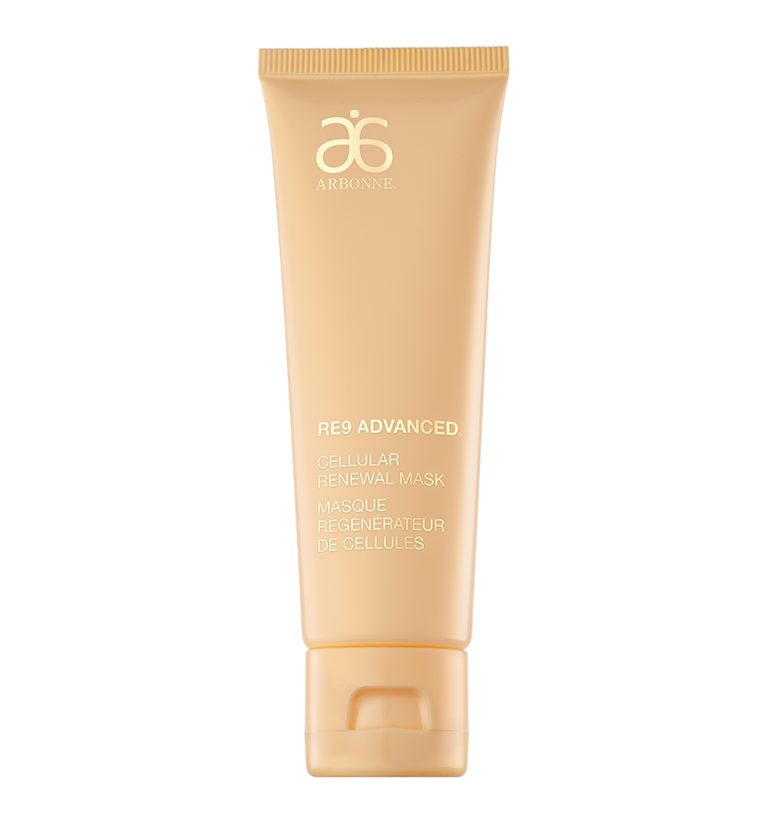
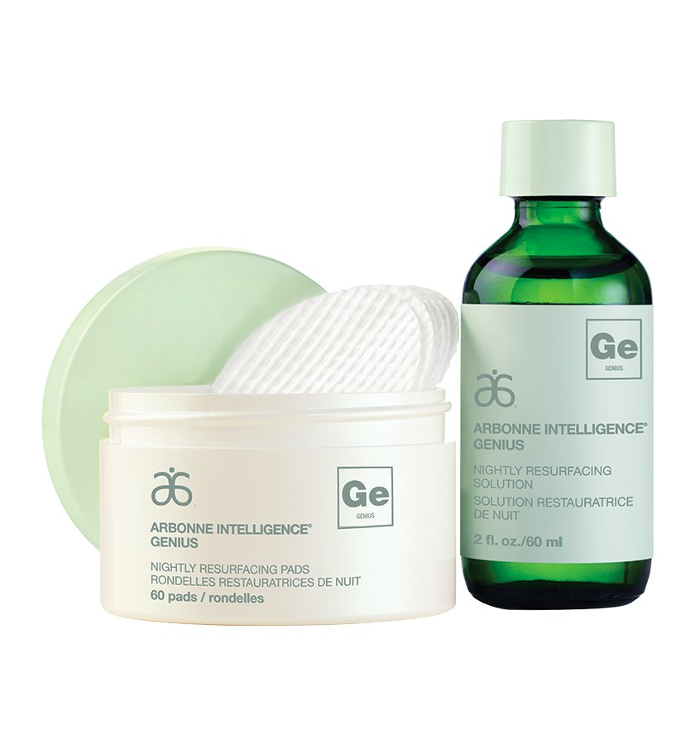
Chemical Exfoliation

Slide 19
Dermis

Slide 20
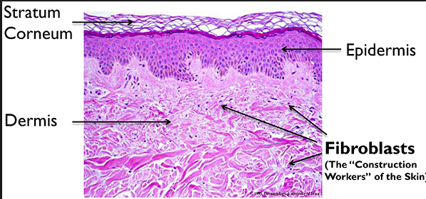
Collagen
.

Slide 21
Peptides
Our peptides increase communication between the epidermis and the dermis

Slide 22
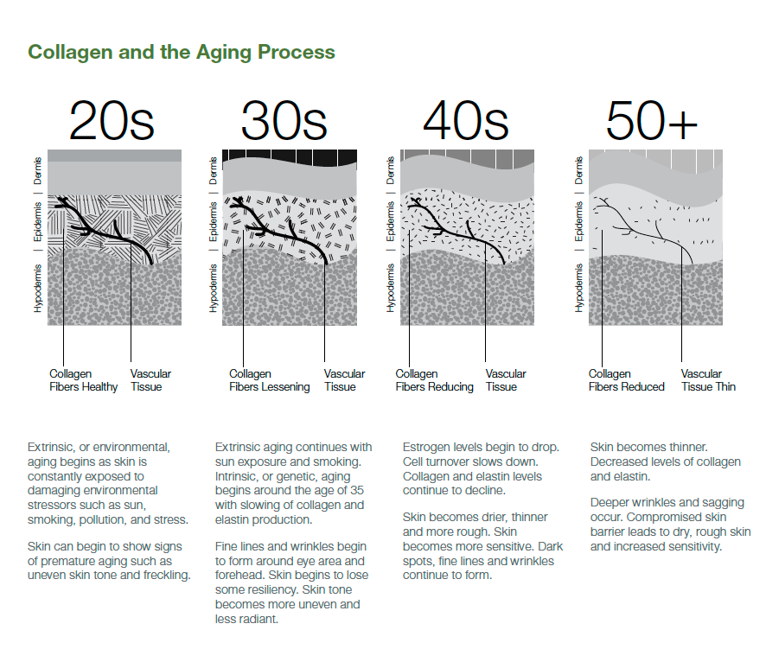

Slide 23
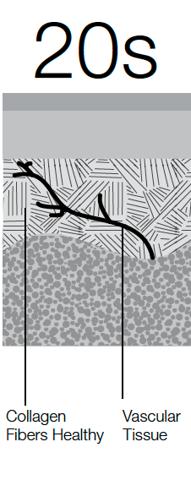
Epidermis
Dermis
Hypodermis

Slide 24
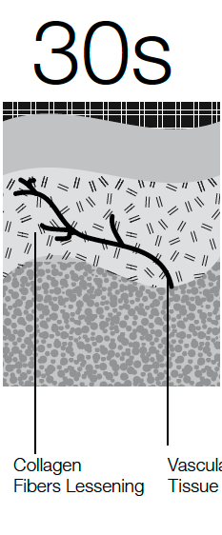
Epidermis
Dermis
Hypodermis

Slide 25
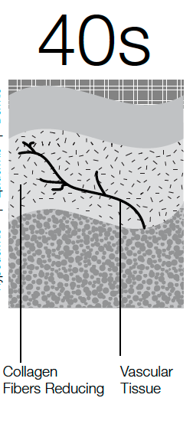
Epidermis
Dermis
Hypodermis

Slide 26
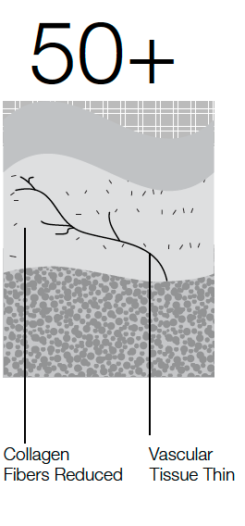
Epidermis
Dermis
Hypodermis

Slide 27
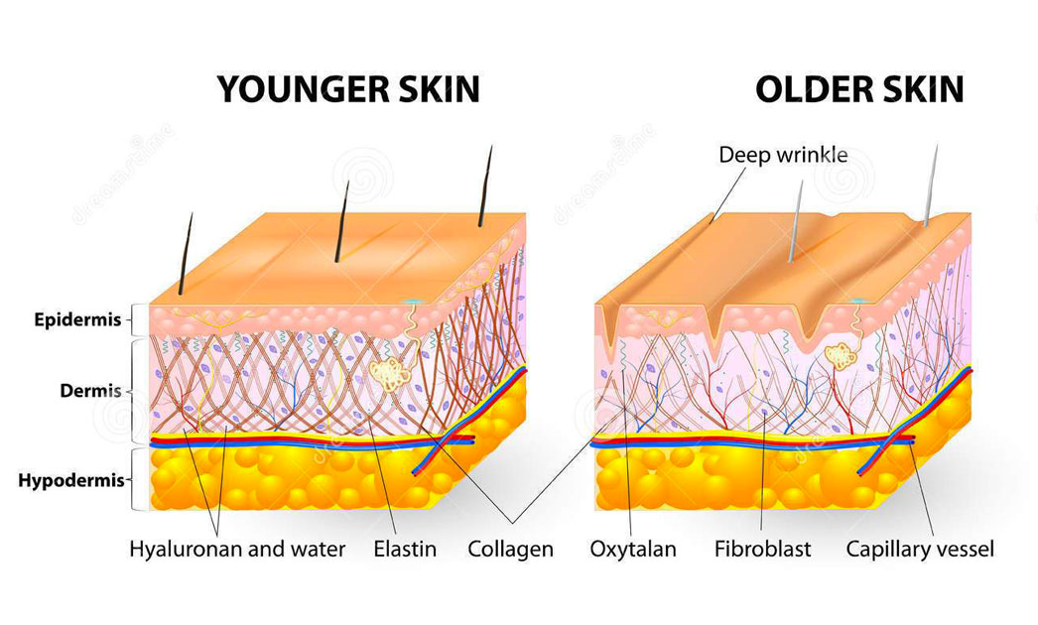
Elastin

Slide 28
Niacinimide
We have Niacinamide throughout our New Re9 Line

Slide 29
8 reasons for Niacinimide
#1 Boosts the immunity of your skin.
#2 Improves epidermal barrier performance.
#3 Improves redness and blotchiness in the skin.
#4 Regulates oil flow.

Slide 30
8 reasons for Niacinimide
#5 Protects skin from infrared light.
#6 Hyper-pigmentation.
#7 Minimize lines and wrinkles.
#8 Dull and sallow skin.

Slide 31
Hypodermis

Slide 32
How does the New Re9 address all of this?

Slide 34
Gold Standard Ingredients

Slide 35
Gold Standard Ingredients
Stabilized Vitamin C
Boosts and maintains moisture, resulting in an improvement in the appearance of fine lines as well as providing moisture barrier protection to restore a natural, youthful glow
Brown algae extract
Helps diminish the appearance of fine lines and wrinkles by
moisturizing the skin’s outer layer

Slide 36
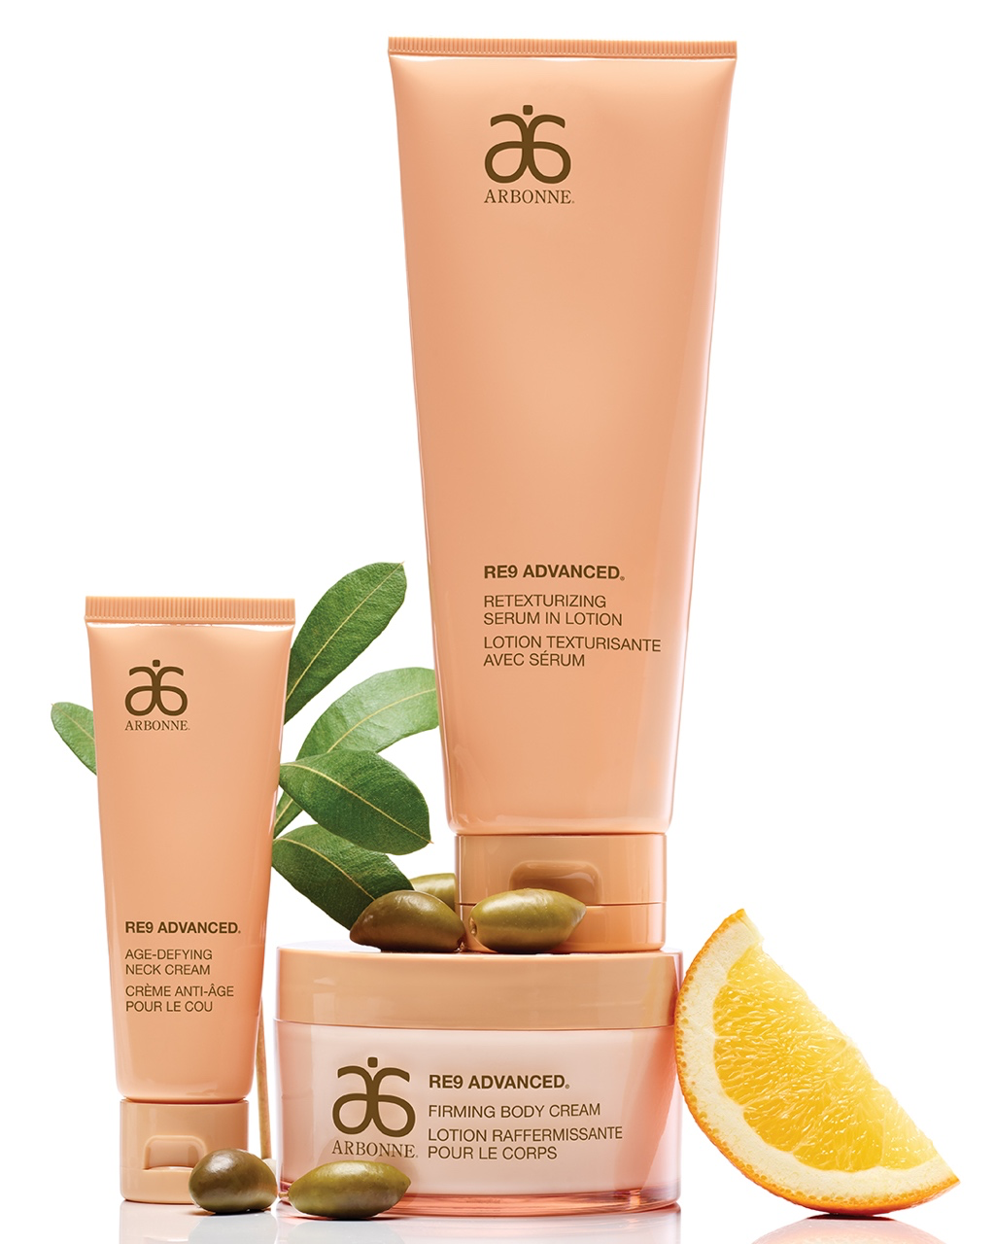
Cleaner for Better
RE9 Advanced products are now
formulated without EDTA,
PEG,
butylene
glycol,
orange oil,
retinyl palmitate,
polysorbate or urea. *
*Pertains to non-SPF products in RE9 Advanced

Slide 37
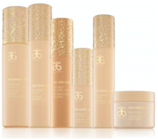
RE9 Advanced Collection Story
Developed to address the specific needs of aging skin.
When used consistently as a twice-daily skincare regimen, the products help to improve the appearance of skin firmness, elasticity and tone, minimize the appearance of fine lines and wrinkles and improve hydration, helping skin look visibly rejuvenated and youthful.

Slide 38
Let’s Review the Layers of Skin….

Slide 39
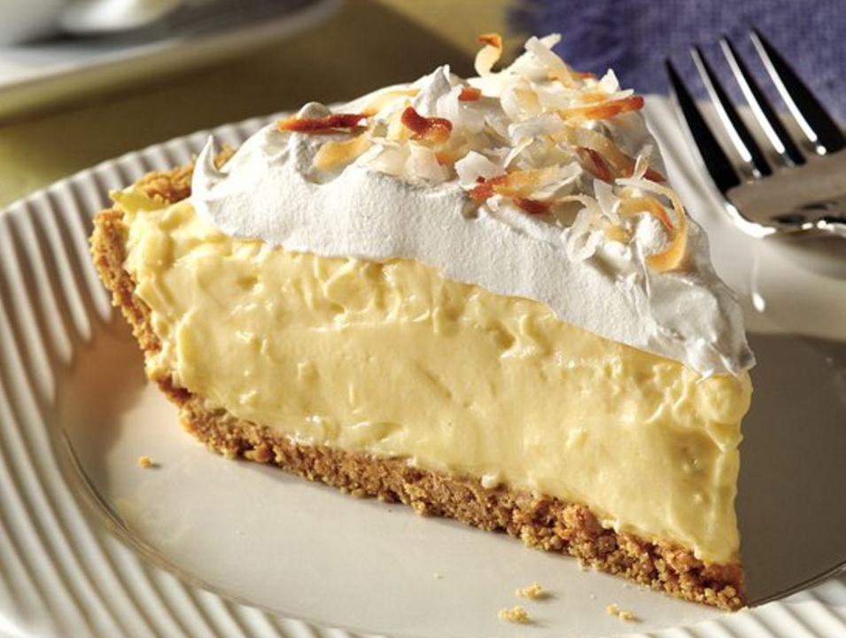

Slide 40
RE9 Advanced
Cleanse
Treat
Protect

Slide 41
Cleanse

Slide 42
NEW:

Slide 43
NEW:

Slide 44
Treat

Slide 45
NEW:

Slide 46
NEW:

Slide 47
Protect

Slide 49
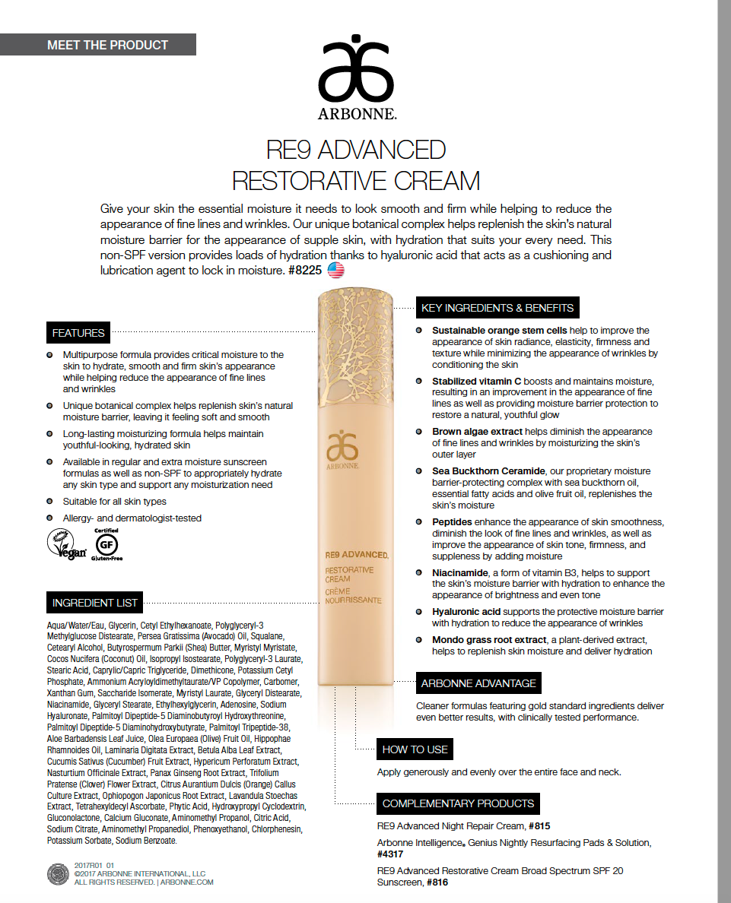
NEW NON-SPF:

Slide 50
NEW:

Slide 51
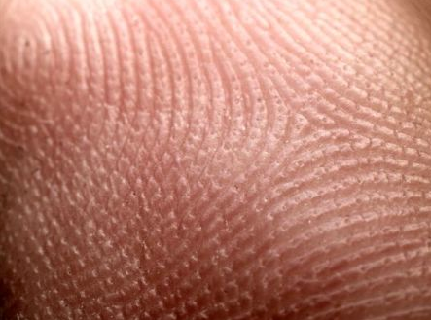
PERSONALIZING YOUR REGIMEN WITH THE GENIUS ULTRA
Serum – Use with the Genius Ultra to nourish skin, helping to reduce the appearance of fine lines and wrinkles
Nourishing Facial Oil – Add to serum to increase hydration as well as improve the glide while using the Genius Ultra
Eye Cream – Use with the Genius Ultra to care for the delicate eye area
Day or Night Cream – Finish by moisturizing and protecting skin. Use non-SPF day or night cream with the Genius Ultra to enhance results
Lip Treatment – Use with the Genius Ultra as an extra step to care for the delicate skin on and around the lip area
Neck Cream – Use with the Genius Ultra to moisturize and care for the delicate skin on the neck and décolleté area
Skin has ridges- The Ultra can get product past the ridges and into our skin better than fingertips alone

Slide 52
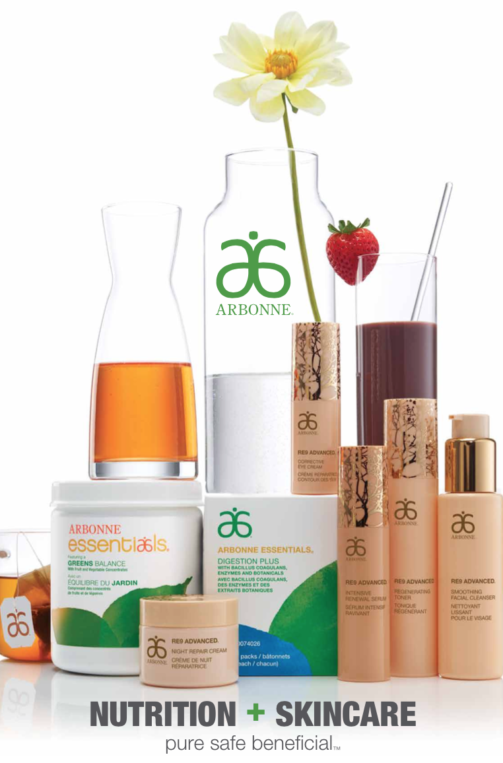

Slide 53
Gut- Skin Connection
“

Slide 54
Break through to your best Skin!

