Slide 1
Guidance document Promotion & use of Canadian Nutritional Products

Slide 2
health Canada’s natural Health product?
What is a Natural Health Product (NHP) Under the Natural Health Products Regulations, which came into effect on January 1, 2004, natural health products (NHPs) are defined as:
Probiotics
Herbal remedies
Vitamins and minerals
Homeopathic medicines
Traditional medicines such as traditional Chinese medicines
Other products like amino acids and essential fatty acids

Slide 3
health Canada’s natural Health product?
Licensed Natural Health Products Database (LNHPD)
Health Canada has established the Licensed Natural Health Products Database contains information about natural health products that have been issued a product license by Health Canada.
Products with a license have been assessed by Health Canada and found to be safe, effective and of high quality under their recommended conditions of use.
You can identify licensed natural health products by looking for the eight-digit Natural Product Number (NPN) on the label.
The following Arbonne Nutrition products include:

Slide 4
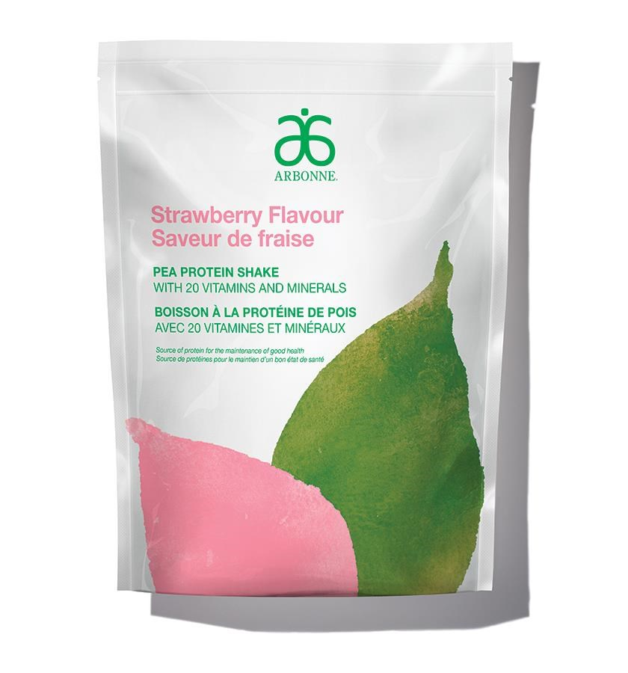
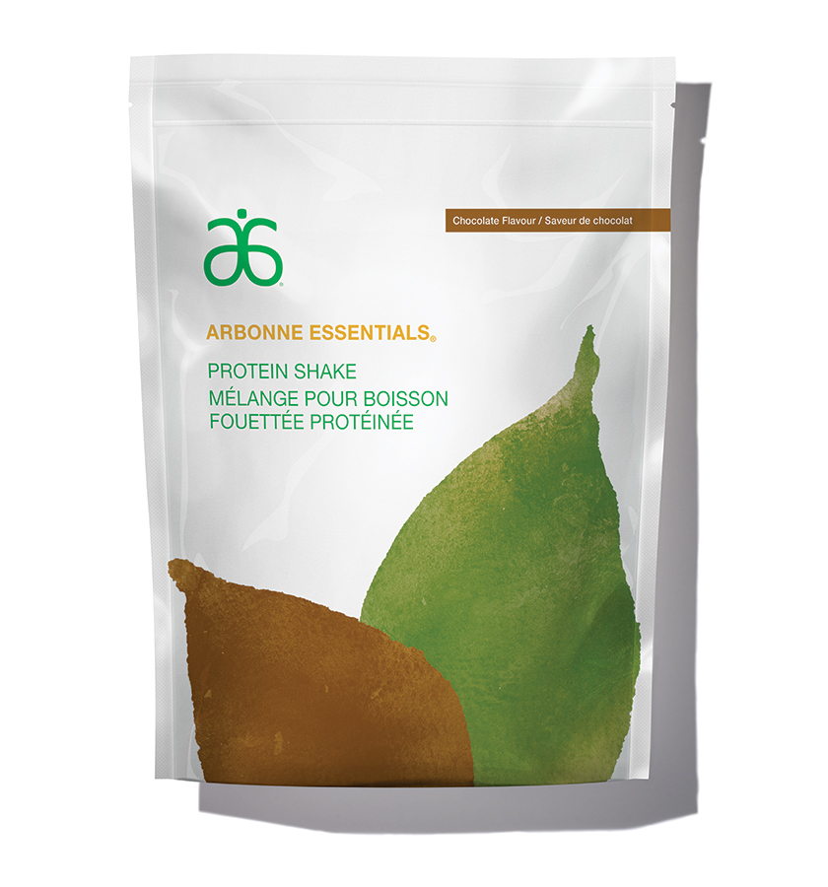
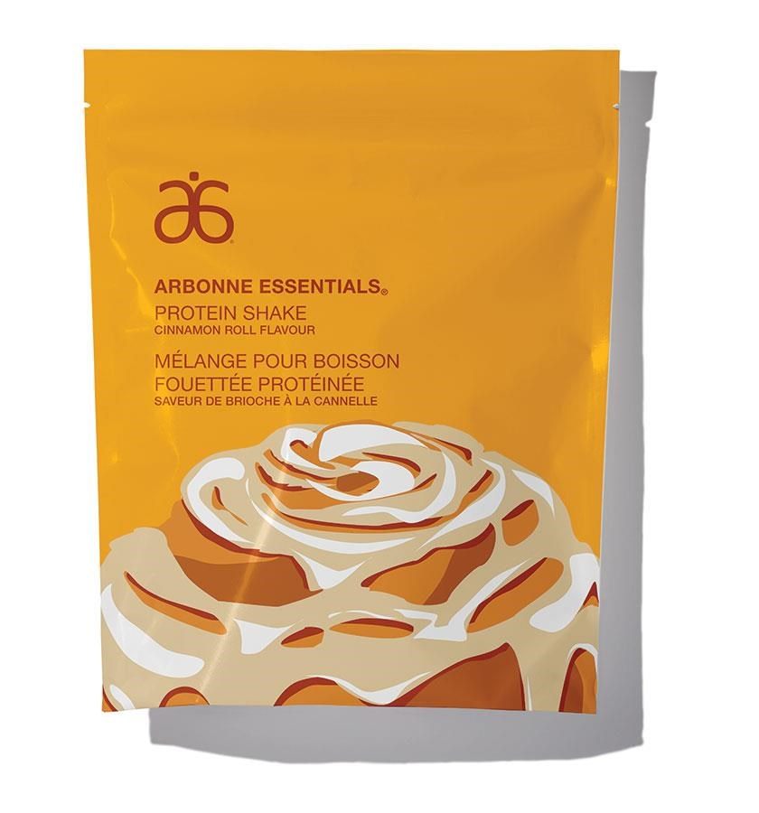
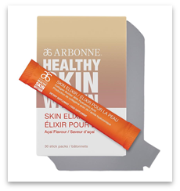
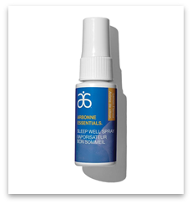
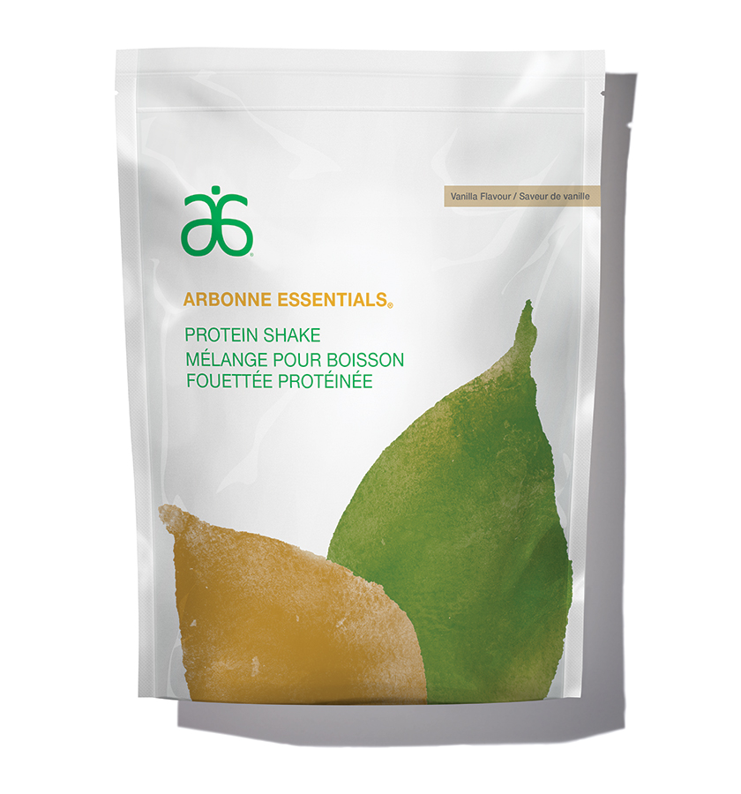
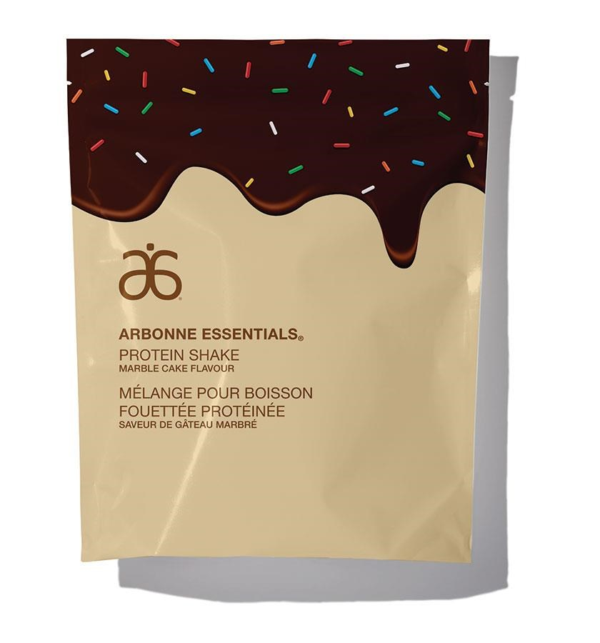
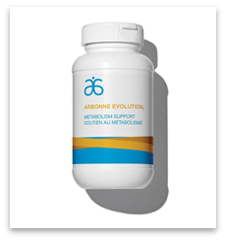
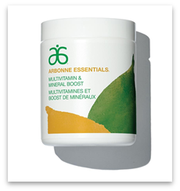
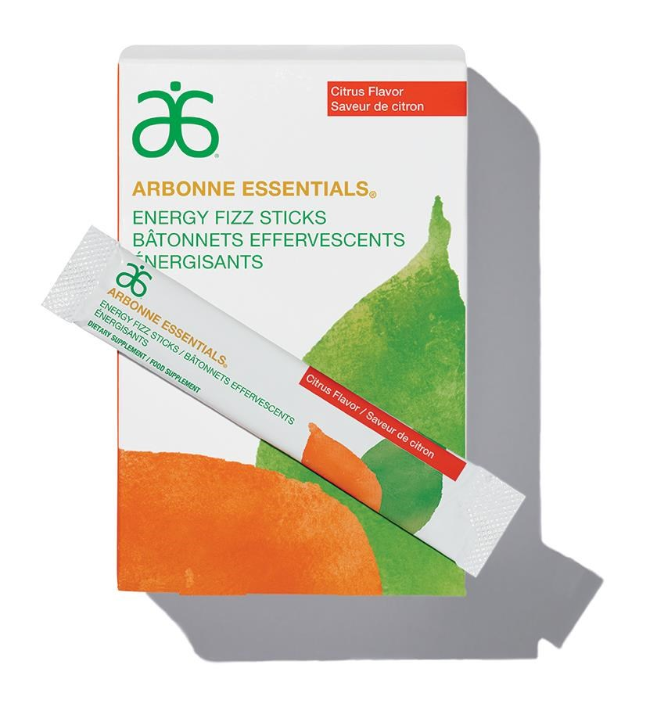
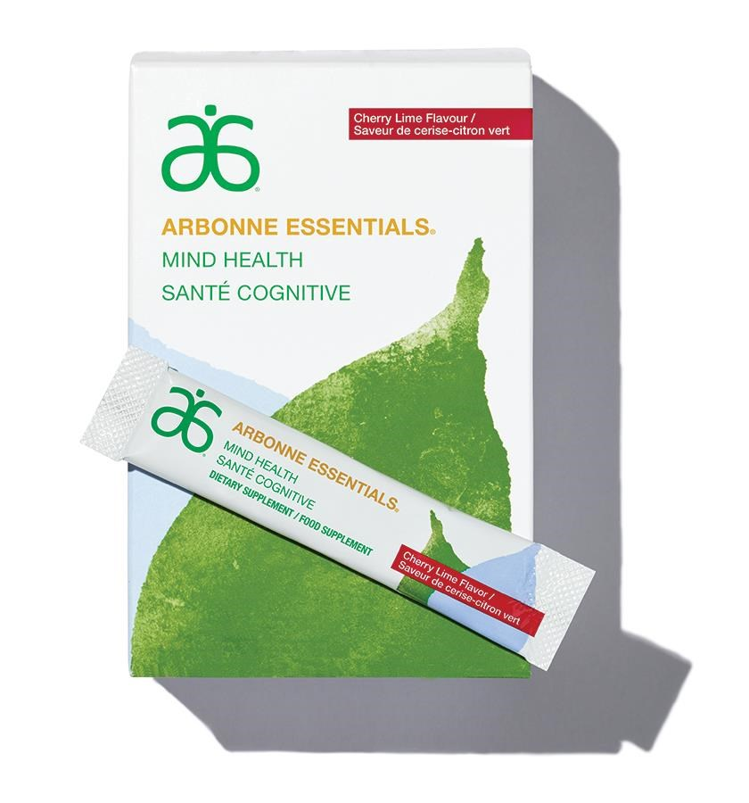
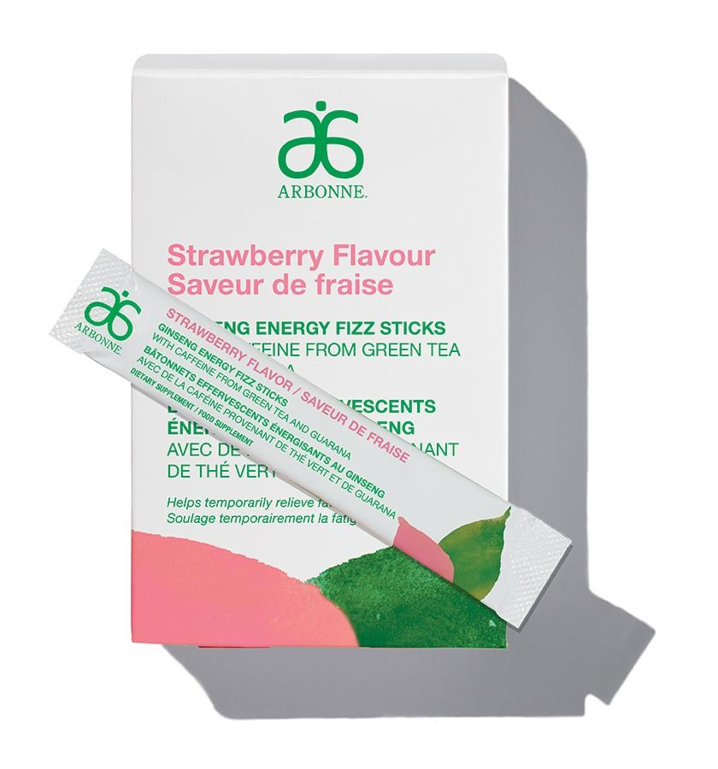
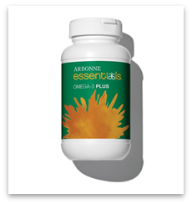
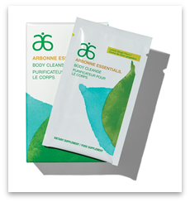
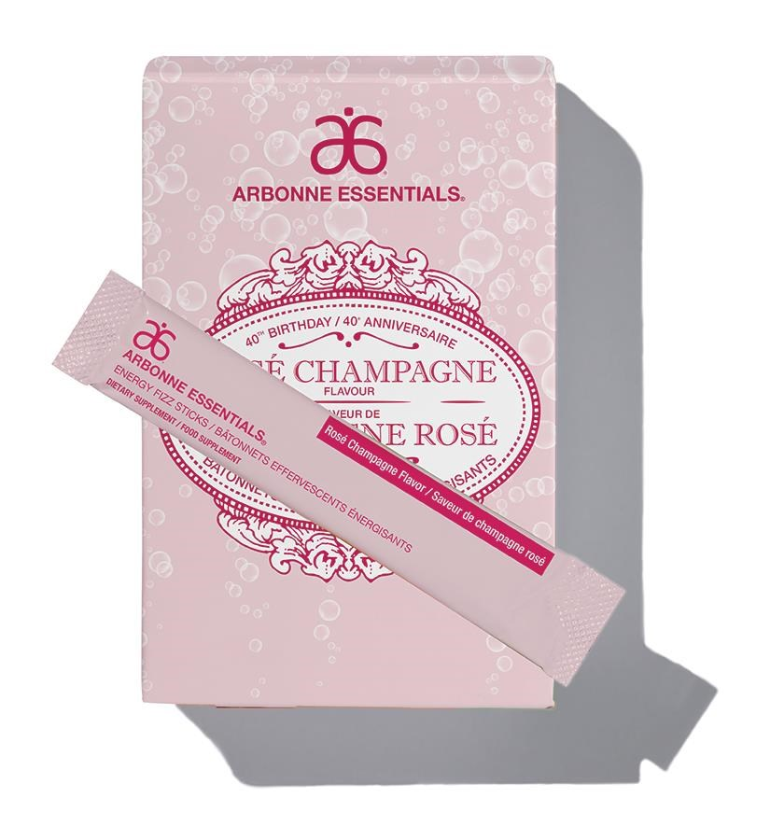
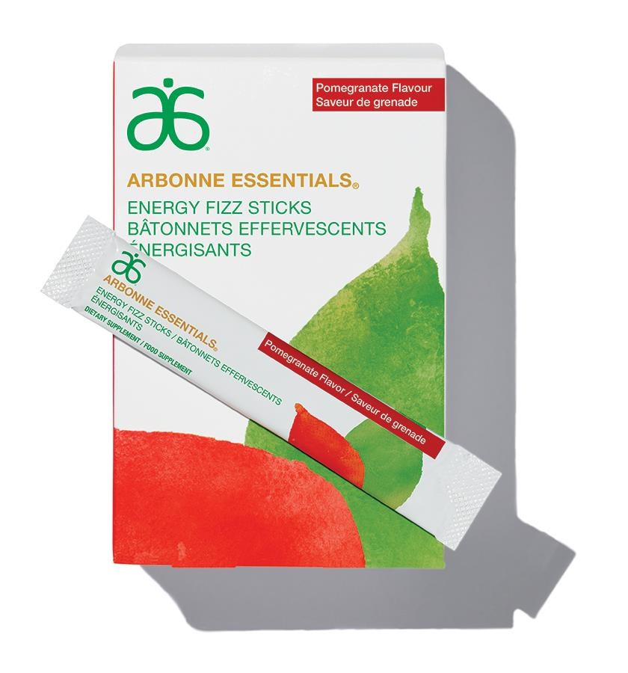
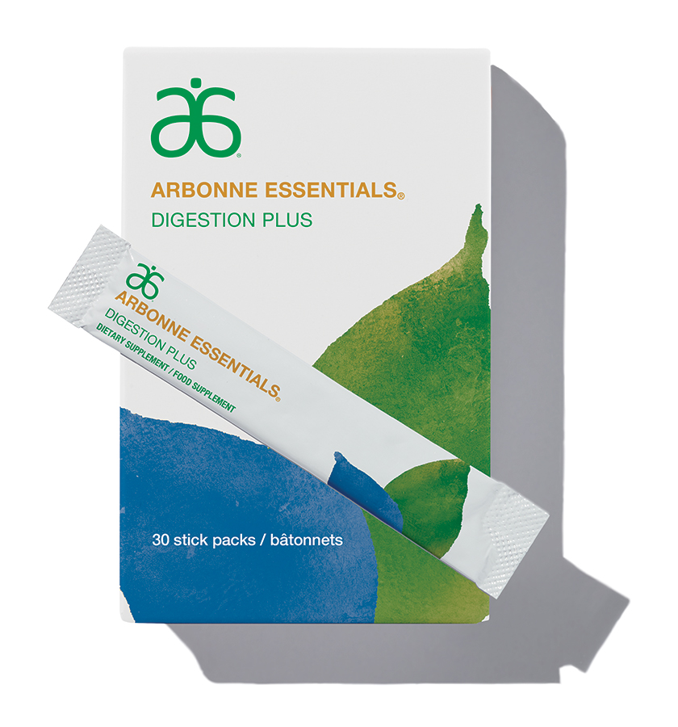
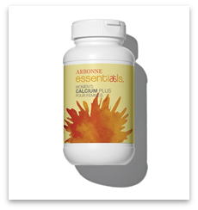
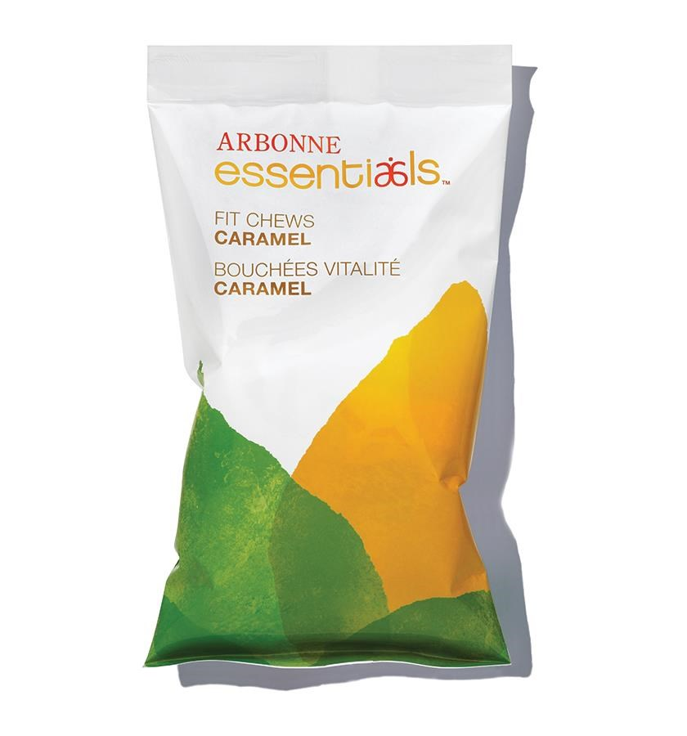
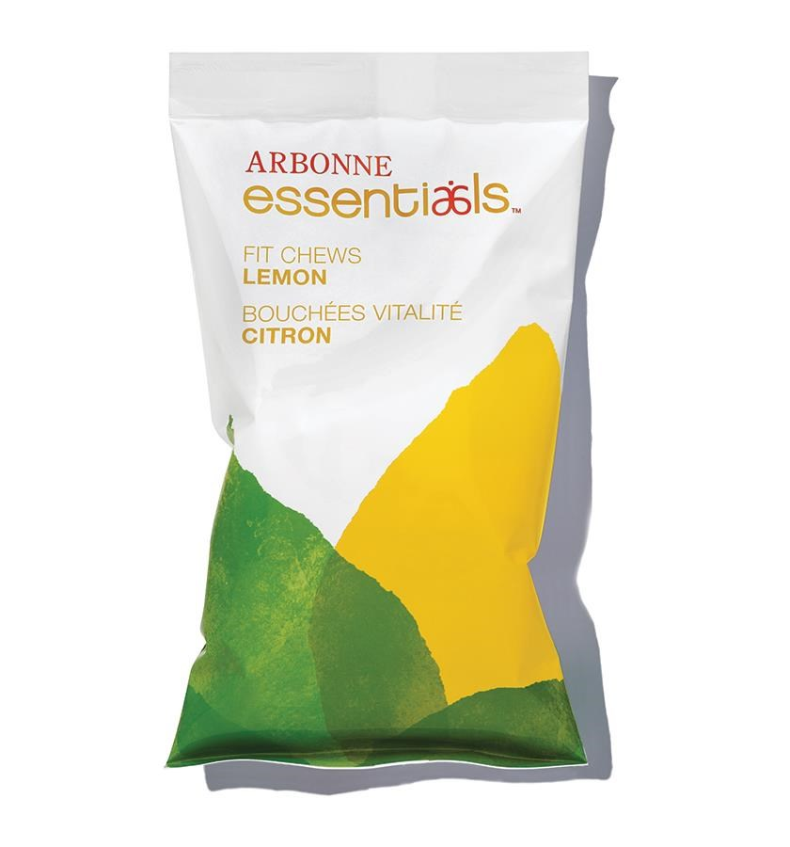
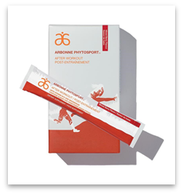
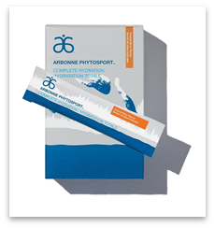
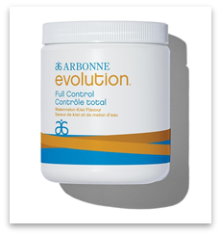
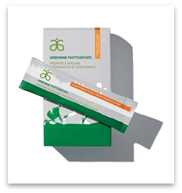
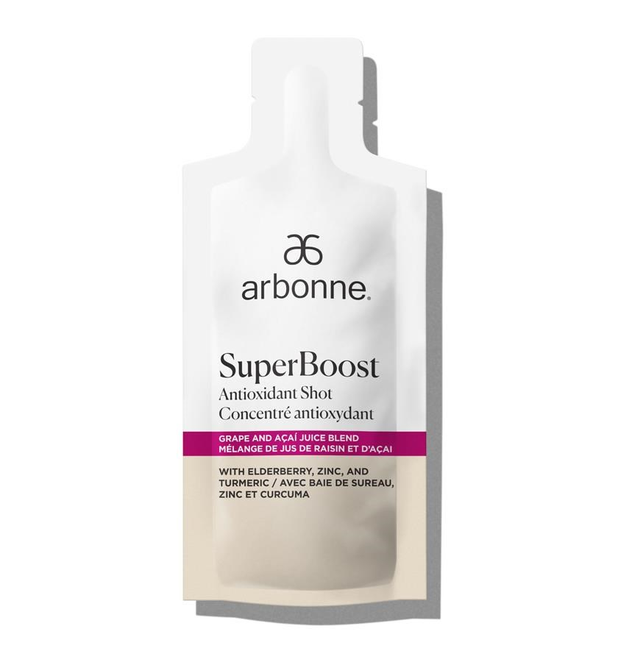
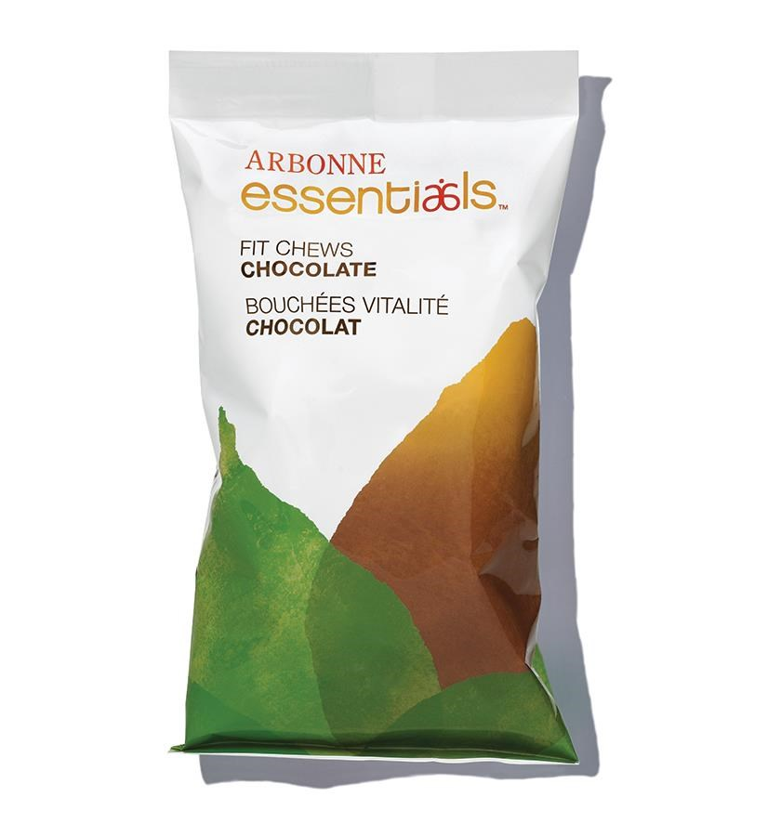
Arbonne Canada’s Licensed as NATURAL HEALTH PRODUCT (NHP)

Slide 5
Natural Health Products
INCLUDES:
#6105 Healthy Skin Within Skin Elixir (NPH #80092835)
#2063 Essentials Digestion Plus (NPH #80094881)
#2064 Essentials Multivitamin & Mineral Boost (NPH #80091871)
#6102 Essentials Mind Health (NPH #80081437)
#2968 Pea Protein Shake — Strawberry (NPH #80092210)
#2964 Essentials Protein Shake — Marble Cake (NPH #80092210)
#2963 Essentials Protein Shake — Cinnamon Roll (NPH #80092210)
#2957 Essentials Protein Shake — Chocolate (NPH #80091916)
#2979 Essentials Protein Shake — Vanilla (NPH #80092210)
#2073 Essentials Protein Shake, 10-pack — Chocolate (NPH #8009196)
#2074 Essentials Protein Shake, 10-pack — Vanilla (NPH #80092210)
#6103 Essentials Body Cleanse (NPH #80081728)
#2114 Essentials Energy Fizz Sticks — Rosé Champagne (NPH #80086207)
#2111 Ginseng Energy Fizz Sticks — Strawberry Flavour (NPH #80086207)
#2112 Ginseng Energy Fizz Sticks — Watermelon Flavour (NPH #80086207)
#2077 Essentials Energy Fizz Sticks — Citrus (NPH #80086207)
#2079 Essentials Energy Fizz Sticks — Pomegranate (NPH #80086207)
#2067 Essentials Fit Chews — Caramel (NPH #80058196)
#2068 Essentials Fit Chews — Chocolate (NPH #80058196)
#6114 Essentials Fit Chews — Lemon (NPH #80058196)
#6218 Essentials Sleep Well Spray (NPH #80048461)
#2066 Essentials Omega-3 Plus (NPH #80036720)
#2062 Essentials Women’s Calcium Plus (NPH #80024576)
#6099 PhytoSport Prepare & Endure (NPH #80060882)
#6264 PhytoSport Complete Hydration (NPH #80060879)
#6100 PhytoSport After Workout (NPH #80060881)
#6210 Evolution Full Control (NPH #80052758)
#2618 Evolution Metabolism Support (NPH #80058446)
#6298 SuperBoost Antioxidant Shot (NPH #80090250)
#6088 InnerCalm Adaptogenic De-Stress Powder (NPH #80102499)

Slide 6
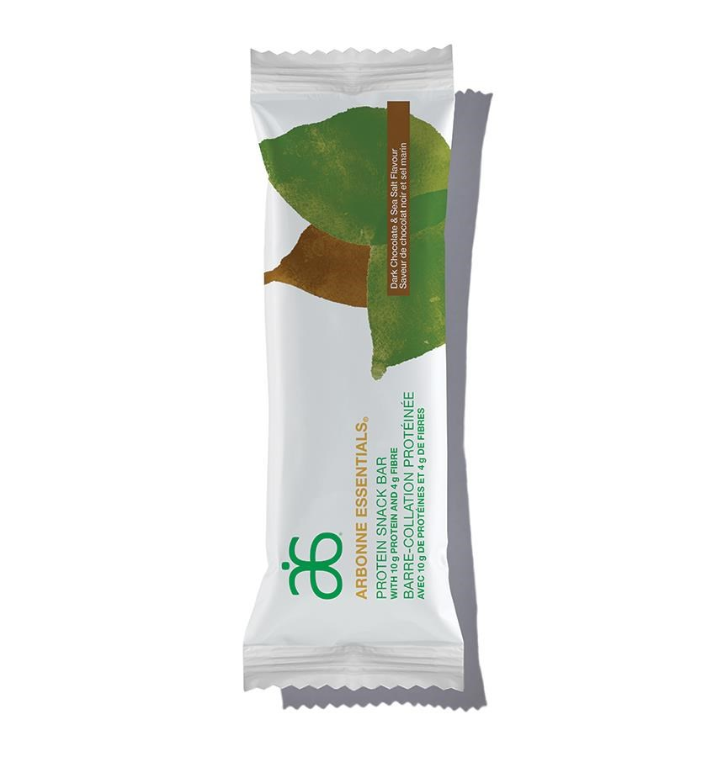
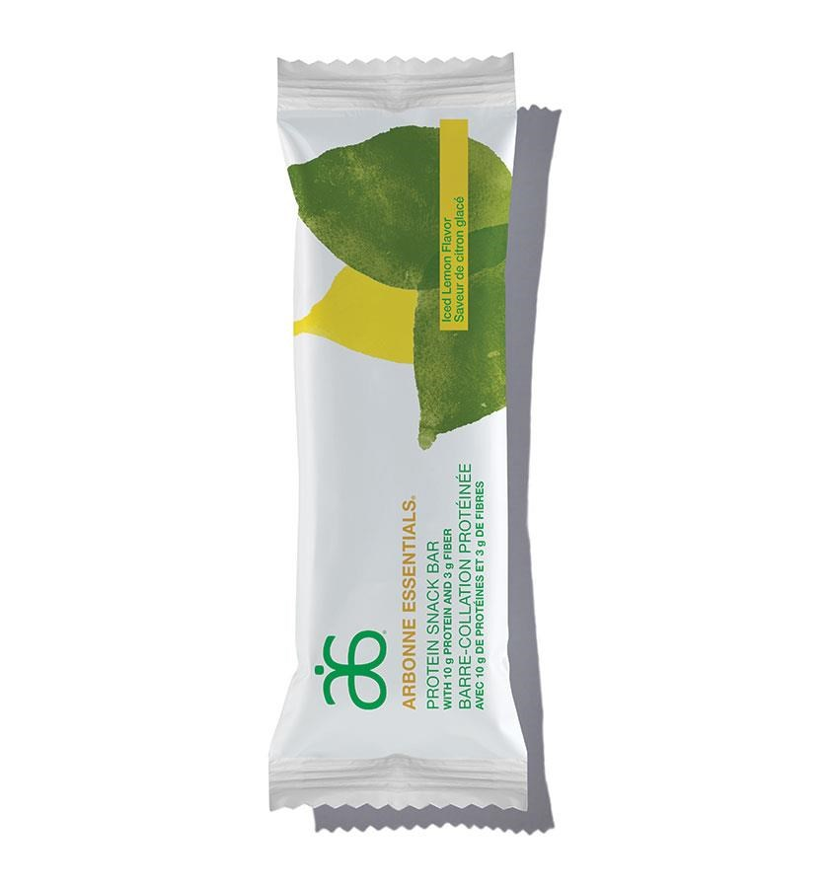
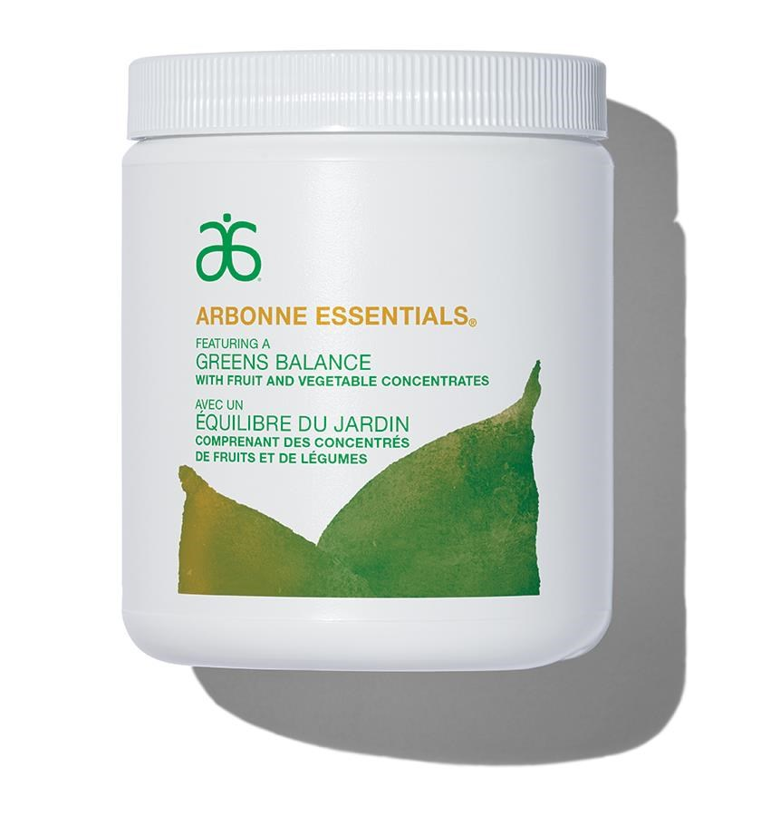
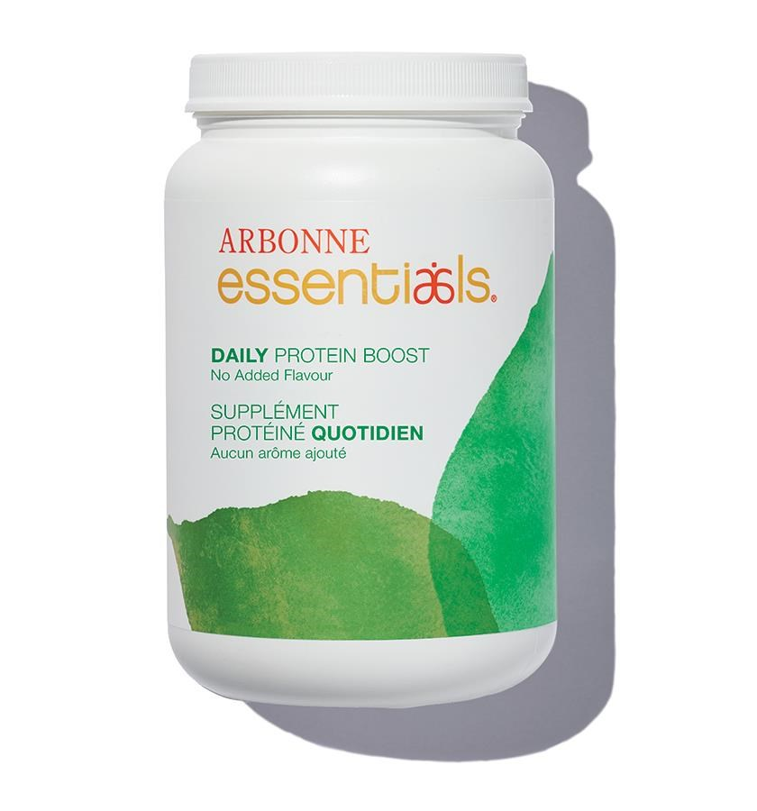
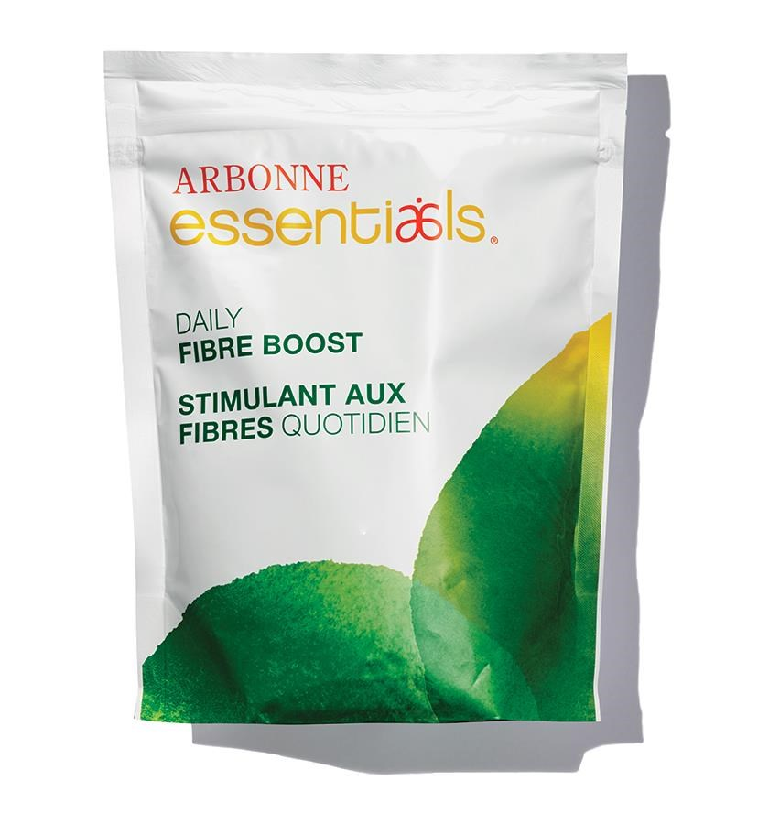
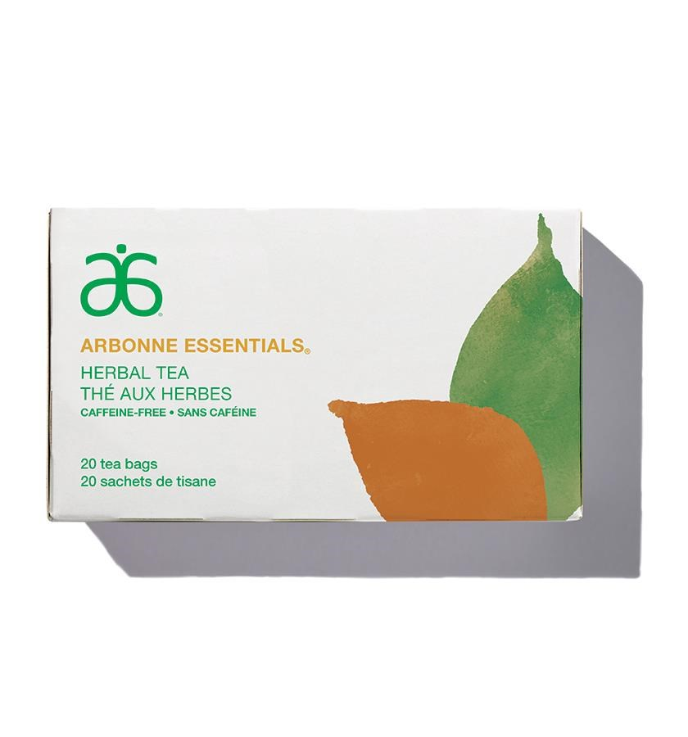
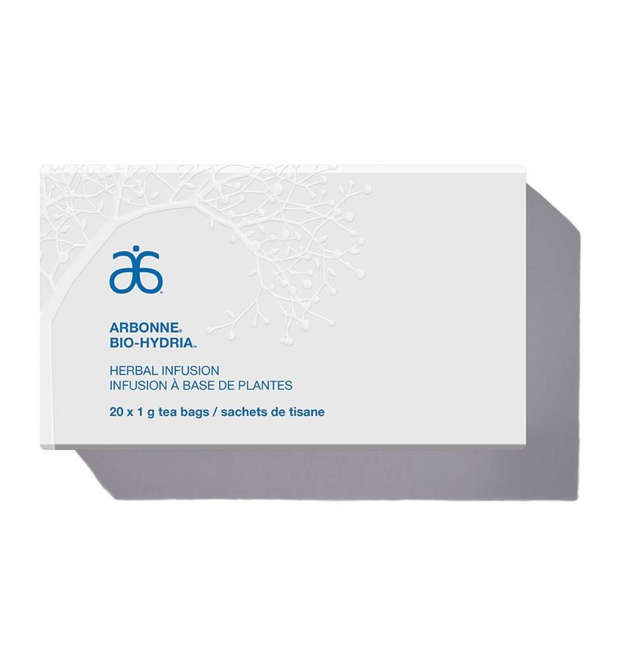
Arbonne Canada’s FOOD PRODUCTS
PRODUCT NAME (ENG)
Daily Protein Boost | FOOD
Daily Fibre Boost | FOOD
Greens Balance | FOOD
Herbal Tea | FOOD
Herbal Infusion | FOOD
Protein Snack Bar — Iced Lemon Flavor | FOOD
Protein Snack Bar — Dark Chocolate & Sea Salt Flavor | FOOD

Slide 7
Health Canada NHP Licensing Our Health Canada approved licensed NHP products ARE for the INDIVIDUAL consumption ONLY AND NOT FOR CONCOMITANT USE. When we blend or promote 2 or more NHP products (Digestion Plus, Protein Mix, Skin Elixir etc.) ￼the total ingredients list no longer matches our approved license.

Slide 8
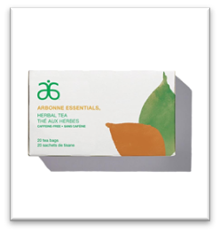
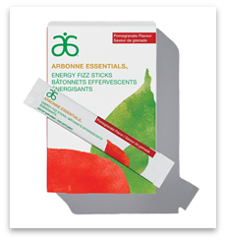
A Tizzy – is aligned as it is one Food and one nHP
#2076 Herbal Tea
FOOD
#2079 Essentials Energy Fizz Sticks — Pomegranate
(NPH #80086207)

Slide 9
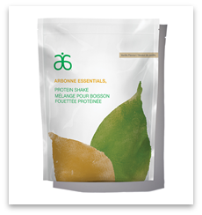
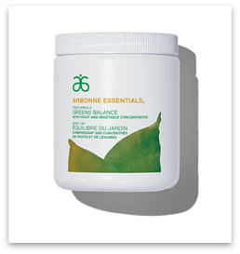
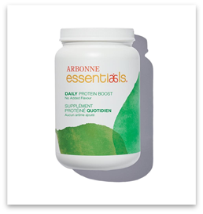
A shake blend – is aligned as it is 2 FoodS and nHP
#2979 Essentials Protein Shake — Vanilla (NPH #80092210)
#6232 Greens Balance
FOOD
#6296 Daily Protein Boost
FOOD

Slide 10
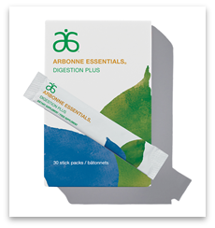
Green Shot is not aligned as it is multiple nHP
#6232 Greens Balance
FOOD
#6105 Healthy Skin Within Skin Elixir (NPH #80092835)
#2063 Essentials Digestion Plus (NPH #80094881)

Slide 11
General Rules around use & Social Media for Foods
When creating nutrition-based programs for your teams:
Do not promote or encourage blending of 2 NHP products - including Green Shot Challenges that mix two or more NHP products
Do not post on social media the blended usage of two or more NHP products
Check packaging for NPN number as this identifies a product as a Natural Health Product (NHP)

