Slide 1
The Up and Coming Men and Generation Y
Regional VP:
Luke Huntington

Slide 2
Men
May be different from women, but Arbonne creates an equal playing field
Personal appearance is a priority; also now more acceptable
Being metrosexual has now become a norm
Looking younger and fitter = SUCCESS

Slide 3
Introductions
LEAD WITH THE BUSINESS!!!
The products become a widget. The best product is the business model
One-on-one meetings is the most successful approach
Don’t spend a lot of time talking about the products. Men want to get down to business

Slide 4
What Men Want to Hear
“Network Marketing is the recession proof business model of the 21st century.” (Robert Kiyosaki)
“Health and wellness is the next trillion dollar industry. We are in a wellness revolution.” (Paul Zane Pilzner)
“If I had to start over again, I would be in network marketing.” (Bill Gates)

Slide 5
Follow up
Offer a fit kit
FC5 tote bag
RE9 advance men
Protein samples
Immunity booster
Digestion plus
Fizz sticks
Must give them an RE9 full size kit in order to have a follow up meeting with them
By showing men how to use these products daily, we can show them how to build a huge business

Slide 6
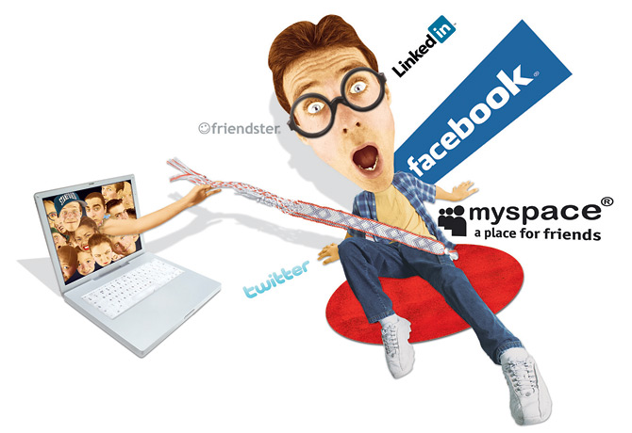
Generation Y

Slide 7
The “Fun” Facts
27% of graduates get a job that is somewhat related to their degree
73% of graduates fail to get a job in their related field
There isn’t any opportunity out there, and they know it
Leave school with incredible debt with no way to pay it off

Slide 8
The Stereotype
“You can do anything you want…….”
Gen Y’s have a sense of entitlement
They aren’t lazy, but they are used to the silver platter
Gen Y’s are the most intelligent generation so far; but there isn’t any opportunity

Slide 9
Communication
Gen Y’s are tech dependent. Can’t go a day without our phones, Facebook, etc…
We MUST get them on the phone!
Our key phrases:
Six figure income
Part time
Make your own schedule
Free travel
Free car

Slide 10
At The Meeting
One-on-one meetings. Allows them to see and feel your passion and excitement
They love to talk about ourselves; so let them!!
When giving your background, relate your why to them. Tailor your language
Gen Y’s want to hear the facts, not the fluff
They are in it for themselves, but not by themselves

Slide 11
Follow up
Younger Gen Y’s (lower 20’s): FC5 set
Older Gen Y’s (upper 20’s: RE9 set
After the meeting, before your second meeting, add them on Facebook
Let the visual evidence work it’s magic, and let the products do the talking

Slide 12
What it Comes Down To
The three things we do
Stop: buying products off the shelf
Start: buying safer, ultra-premium products from yourself
Teach: others how to redirect their spending to do the exact same thing
No matter who you are talking to, follow the system for success. DUPLICATION, DUPLICATION, DUPLICATION!!

